Slide 1



Key Metrics and Recommendations

Slide 2
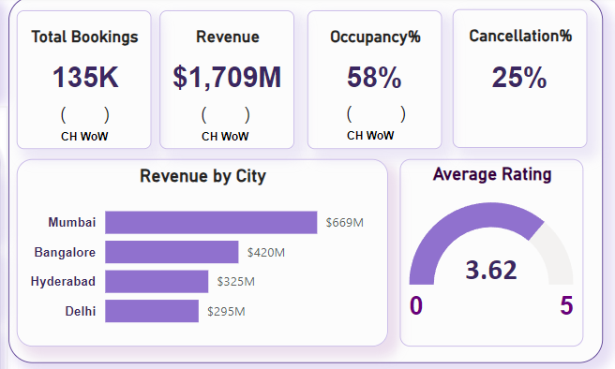
Total Revenue
Total Revenue for all Bookings
Top City
Cancellation
$ 1, 790, 000, 000
Mumbai
$ 669, 000, 000
Cancellation is High
25% of the Total Bookings

Slide 3
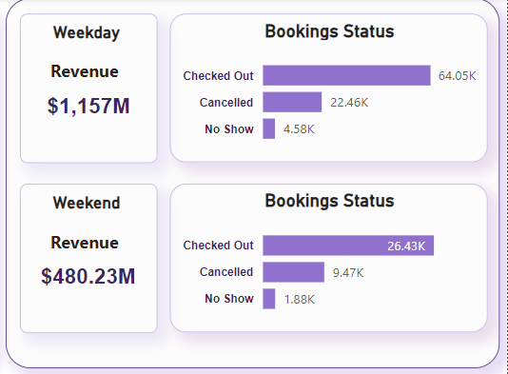
Checked Out
Weekday
Checked Out
Cancellation
# of Bookings: 60, 000
Weekday
4, 580
Weekend
Cancellation
Weekend
1, 880
# of Bookings: 26, 400

Slide 4
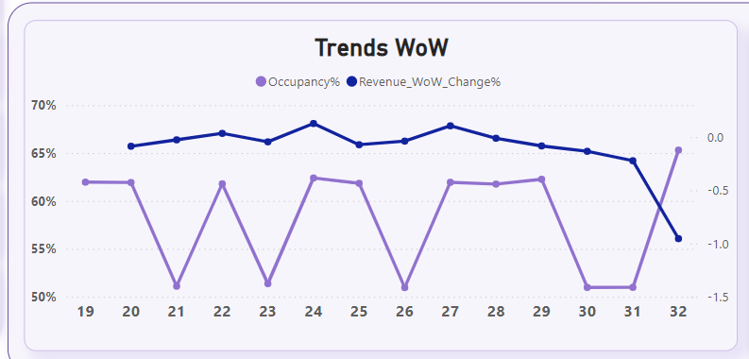
Week 24
Occupancy and Revenue are High
Week 31
Week 21, 23, 26
Occupancy: 64% Revenue: increased 11%
Occupancy are low
Approximately 50%
Unpredictable
Despite the Occupancy increase, The Revenue decreased.

Slide 5
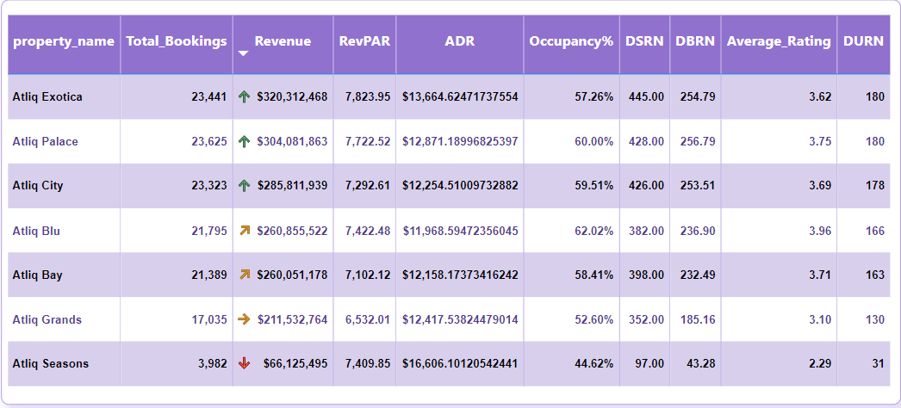
Top 3 Hotels
Revenue
Top Average Rate
Top Occupancy
Atliq Exotica: $ 320, 312, 468
Hotel
Atliq Palace: 3.75
Hotel
Atliq Blue: 62%
Atliq City: $ 285, 811, 939
Atliq Palace: $ 304, 081, 863

Slide 6
Revenue Management
Dynamic Pricing: Implement dynamic pricing strategies to adjust room rates based on demand, seasonality, and competitor pricing. Utilize predictive analytics to forecast demand and optimize pricing.
Promotional Offers: Develop targeted promotional offers and packages during low occupancy periods to attract more guests. This can include discounts, value-added services, and partnership deals.
Occupancy and Booking Management
Increase Direct Bookings: Encourage direct bookings through the hotel’s website by offering exclusive discounts, loyalty programs, and a user-friendly booking experience.
Reduce Cancellations and No-shows: Implement flexible booking policies, send automated reminders, and offer incentives for early check-in or non-refundable bookings to reduce cancellations and no-shows.

